Slide 1
Dr. Yifeng Zhu Electrical and Computer Engineering University of Maine
Embedded Systems
Lab 7
Bluetooth Low Energy (BLE)
Spring 2018

Slide 2
Bluetooth Classic vs Bluetooth Low Energy
Power Consumption
Bluetooth classic has a higher power consumption due to a higher data rate
Applications
Bluetooth classic can stream data and BLE is best for periodic transfer of data
Simultaneous connections
BLE can establish up to 20 connections,
Bluetooth classic can only have 7 connections.

Slide 3
BLE Details
BLE transmits at 1Mbps
Has a range of 2 to 5 meters
BLE operates in the 2.4GHz – 2.48GHz range also known as the industrial, scientific, and medical (ISM) spectrum.
Streaming not available for BLE 4.1 so all data is sent via data packets
Data stored little endian format

Slide 4
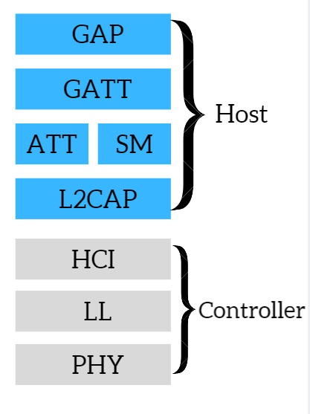
BLE Stack

Slide 5
Generic Access Profile (GAP)
GAP is in controls of advertising and connections.
This layer specifies how devices perform control procedures such as device discovery, connection.
Helps maintain a consistent and interoperable communication

Slide 6
Generic Attribute Profile(GATT)
Defines how data is organized and exchanged between different applications.
Defines the way that services, characteristics, and descriptors can be defined and used.
Built on top of the ATT and SM

Slide 7
Attribute Protocol (ATT)
This allows the device to say what certain pieces of data are.
Each piece of data has an attribute type saying what it is and is defined by a 16 bit universally unique identifier (UUID).
An example of an attribute is shown below
Attribute handle | Attribute type | Attribute Value | Attribute permissions
0x008 | “Battery voltage UUID” | “Battery Voltage Value” | “Read only, No authorization, No authentication”

Slide 8
Security Manager(SM)
Bluetooth low energy link layer supports encryption and authentication.

Slide 9
Logical Link Control and Adaptation Protocol (L2CAP)
Takes multiple protocols and encapsulates them into the standard BLE packet format.
Takes long bits of data and separates them into the 37 bytes maximum payload size for BLE for transmit and vise versa for receive.
In charge of routing the ATT and SM

Slide 10
Host Controller Interface(HCI)
Host and Controller Side
The host communicates via a serial interface SPI, UART, etc. To the HCI on the controller side.
Most of the HCI comes from Bluetooth low energy specifications.
On the controller side it can pull a line high signaling that it has a received a packet and will transmit it to the microcontroller.

Slide 11
Link Layer (LL)
handles packets of data, and interfaces with the physical layer, and in charge of establishing connections.
Information is exchanged via packets, No streaming is available
Advertising packets are used for find and connect to other devices or to broadcast data. Channels 37, 38 39.
Data Packets are used once a connection has been bade is established by master and slave. Channels 0 -36. The table below shows the Packet structure
Bits | 8 | 32 | 8 | 8 | 0-296 (37 Bytes) | 24
Contents | Preamble | Access Address | Header | Length | Data | CRC

Slide 12
Physical Layer(PHY)
Contains the analog communications circuity used for modulating and demodulating analog signals and transforming them into digital symbols.

Slide 13
Standard BLE Stack

Slide 14
Channels
Blue – Advertising Packets
Red – Data Packets
Type
Channel | 37 | 0 | 1 | 2 | 3 | 4 | 5 | 6 | 7 | 8 | 9 | 10 | 38 | 11 | 12 | 13 | 14 | 15 | 16 | 17 | 181 | 19 | 20 | 22 | 23 | 24 | 25 | 26 | 27 | 28 | 29 | 30 | 31 | 32 | 33 | 34 | 35 | 36 | 39
Frequency | 2402MHz | 2404MHz | 2408MHz | 2410MHz | 2412MHz | 2414MHz | 2416MHz | 2418MHz | 2420MHz | 2422MHz | 2424MHz | 2426MHz | 2428MHz | 2430MHz | 2432MHz | 2434MHz | 2436MHz | 2438MHz | 2440MHz | 2442MHz | 2444MHz | 2446MHz | 2448MHz | 2450MHz | 2452MHz | 2454MHz | 2456MHz | 2458MHz | 2460MHz | 2462MHz | 2464MHz | 2466MHz | 2468MHz | 2470MHz | 2472MHz | 2474MHz | 2476MHz | 2478MHz | 2480MHz

Slide 15
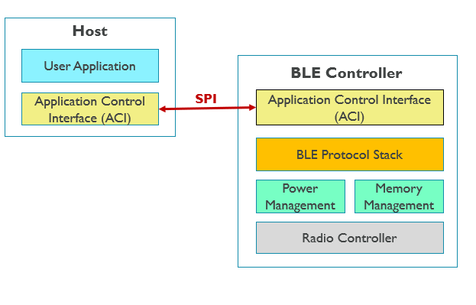
ST Bluetooth Drivers
Application Control Interface (ACI) replaces some of the HCI while implementing GATT, ATT, SM, and L2CAP.
This makes programming very easy using ACI commands that take care of HCI, GATT, ATT, SM, and L2CAP

Slide 16
Basic ACI functions
aci_hal_write_config_data – sets up the public address
aci_gatt_init - initializes the GATT
aci_gap_init_IDB05A1 – initializes the GAP
aci_gap_set_auth_requirement – GAP sets up authentication where you can change the pin/password for the device
aci_hal_set_tx_power_level - Set output power level
Add_ConfigW2ST_Service/Add_ConsoleW2ST_Service/Add_HWServW2ST_Service – Setup and initialize the different services name and UUID that data is going to be exchanged through
aci_gatt_update_char_value – used to update data sent via Bluetooth, all data is associated with a handle that tells it which service and UUID to send it with.

Slide 17
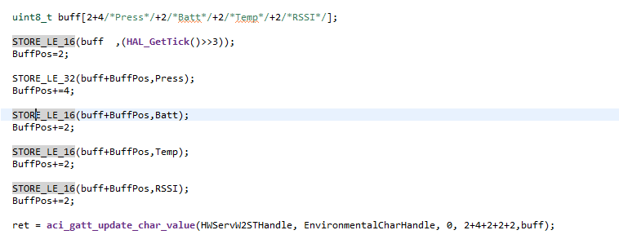
Example code using ACI functions

